Slide 1

Customer Reviews Analysis:
Unlocking Insights into Consumer Satisfaction and Preferences
BY
HAMZA YOUSAF

Slide 2
BUSINESS QUESTIONS & MOTIVATION BEHIND THEM
The first question aims to determine if the customer is likely to recommend the product or not based on their review? (Positive recommendations from satisfied customers can lead to new customers trying out the product, while negative recommendations can have the opposite effect.)
2. The second question seeks to identify if the customer will give the product a rating of 5 or not?
(Marketers need to focus on providing excellent customer experiences and addressing any issues that arise promptly to increase the chances of customers giving higher ratings.)
The third question examines the customer's rating behavior, specifically if they will give a rating of 5, 4, or below 4?
(Understanding the specific rating a customer is likely to give a product can help marketers identify areas for improvement.)

Slide 3
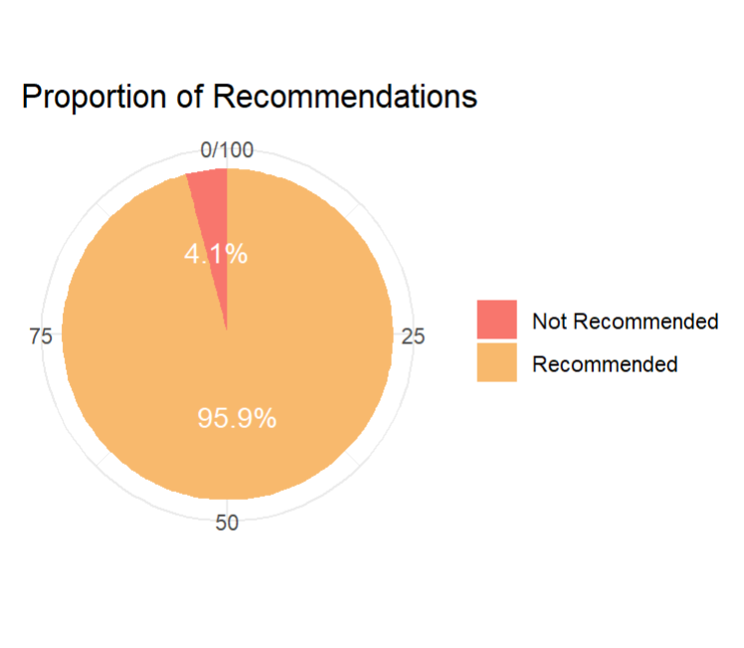
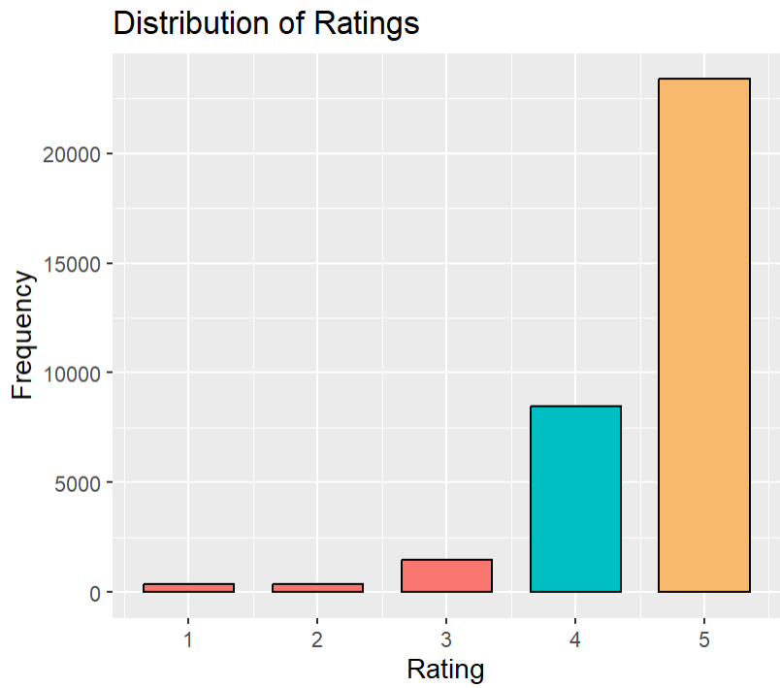
DESCRIPTIVE ANALYSIS:
21 variables and 34,660 observations in this dataset.
4 variables were selected for the study, and an additional 5 product group variables were created from one of the original variables, 'categories'.
Imbalanced dataset
JEFF BEZOS
Founder
The dataset covers a time frame of 3.5 years, ranging from Oct 2014 to Apr2018.

Slide 4
DESCRIPTIVE ANALYSIS:
VARIABLE GROUPS:
Tablets & E-Readers
Amazon Devices
Accessories
Electronics
office & Business
Group | Percent_Recommended | Not_Recommended_Percentage | Average_Rating | Total_Reviews
OffnBuss | 98.1738 | 1.826197 | 4.772355 | 3176
Elec | 96.68956 | 3.310442 | 4.682338 | 5679
Accz | 96.32243 | 3.677574 | 4.670519 | 6662
AmzDvcs | 93.52708 | 6.472919 | 4.560106 | 757
Tblts | 95.16973 | 4.830272 | 4.490526 | 17204
JEFF BEZOS
Founder

Slide 5
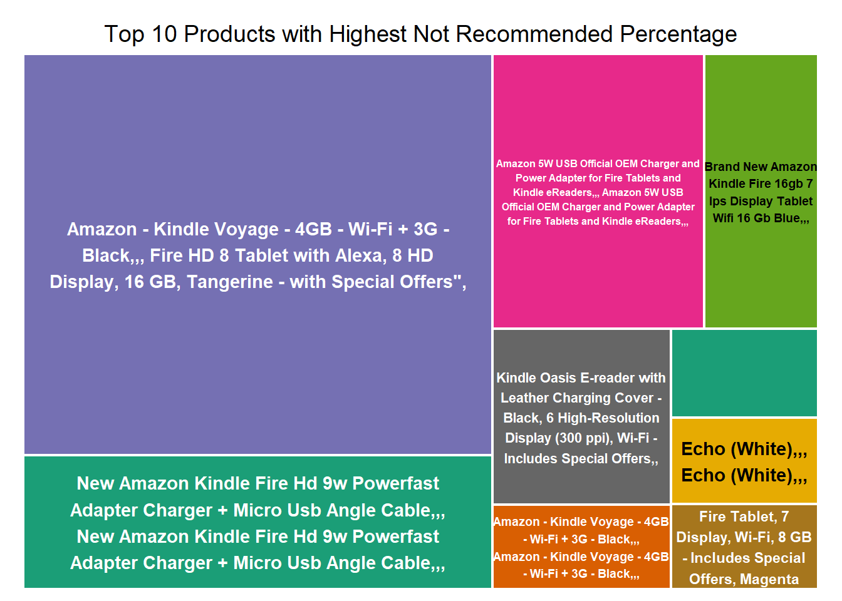

Slide 6
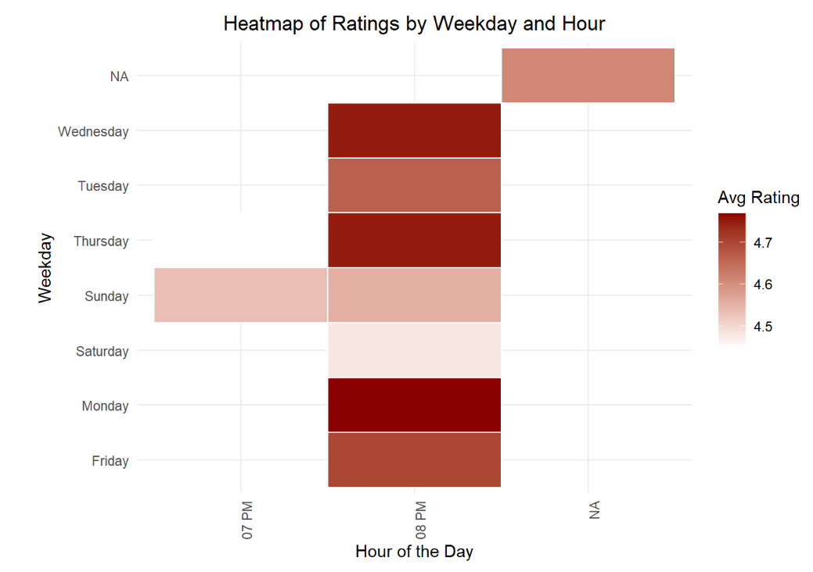
DATA VISUALIZATION:
heatmap - average customer ratings by weekdays and hours - most ratings - 8 PM
Sundays - 7 PM - ratings range from 4.48 to 4.7
Mondays and Wednesdays - highest ratings
Sundays - slightly lower average of 4.55
JEFF BEZOS
Founder

Slide 7

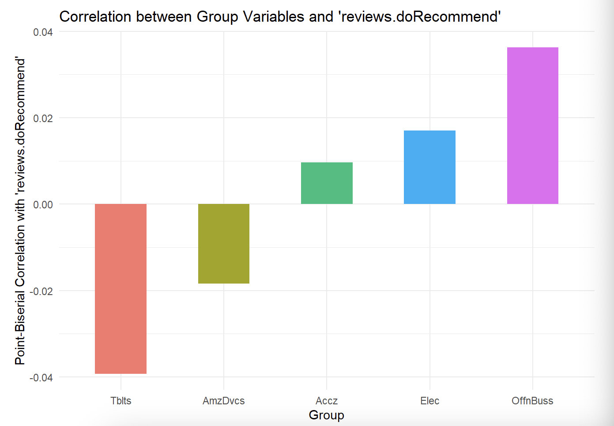
Tblts: weak negative correlation (-0.039) with ‘reviews.doRecommend’
AmzDvcs: weak negative correlation (-0.018) with ‘reviews.doRecommend’
Accz: weak positive correlation (0.010) with ‘reviews.doRecommend’
Elec: weak positive correlation (0.017) with ‘reviews.doRecommend’
OffnBuss: higher positive correlation (0.036) with ‘reviews.doRecommend’

Slide 8
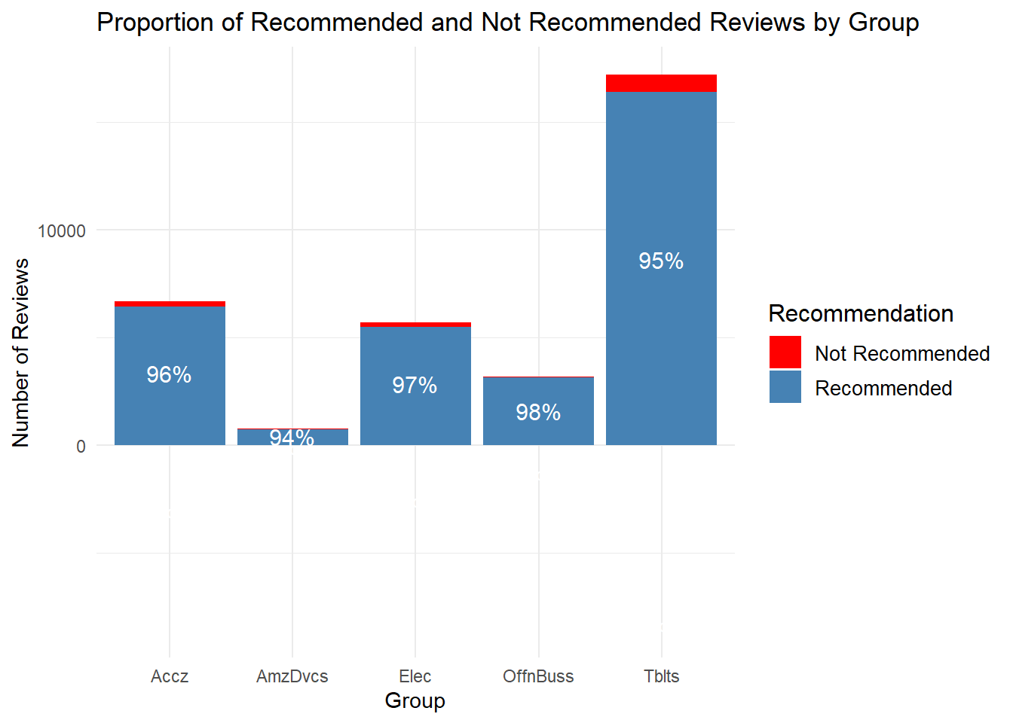
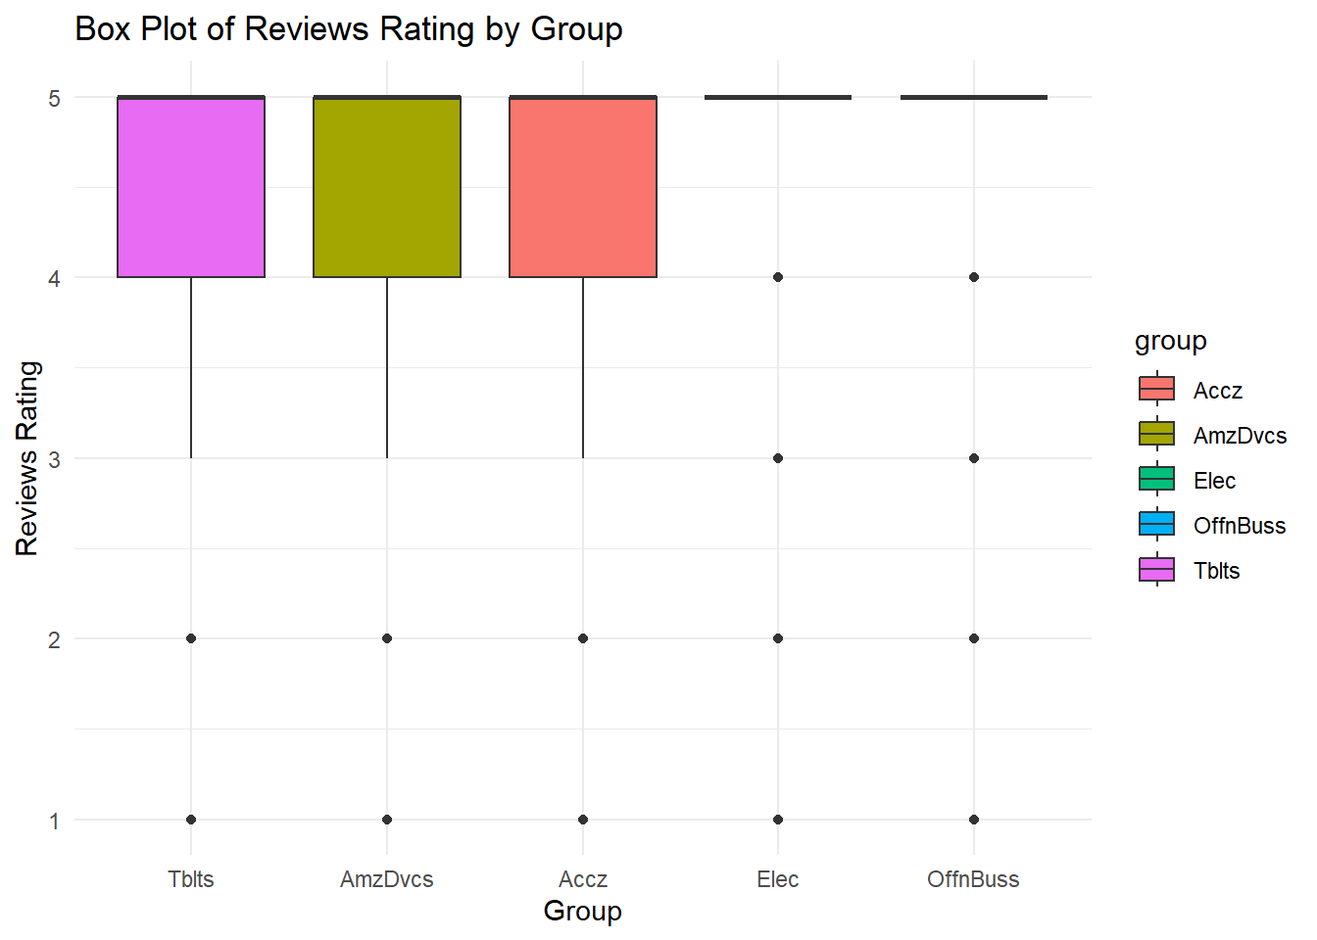
EVALUATING PRODUCTS REPUTATION

Slide 9
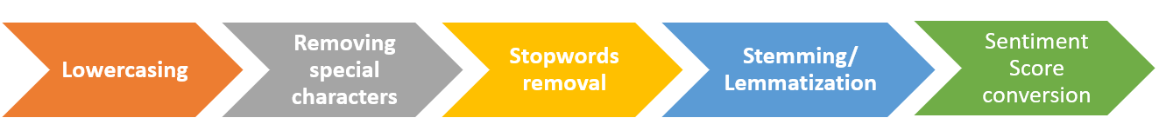
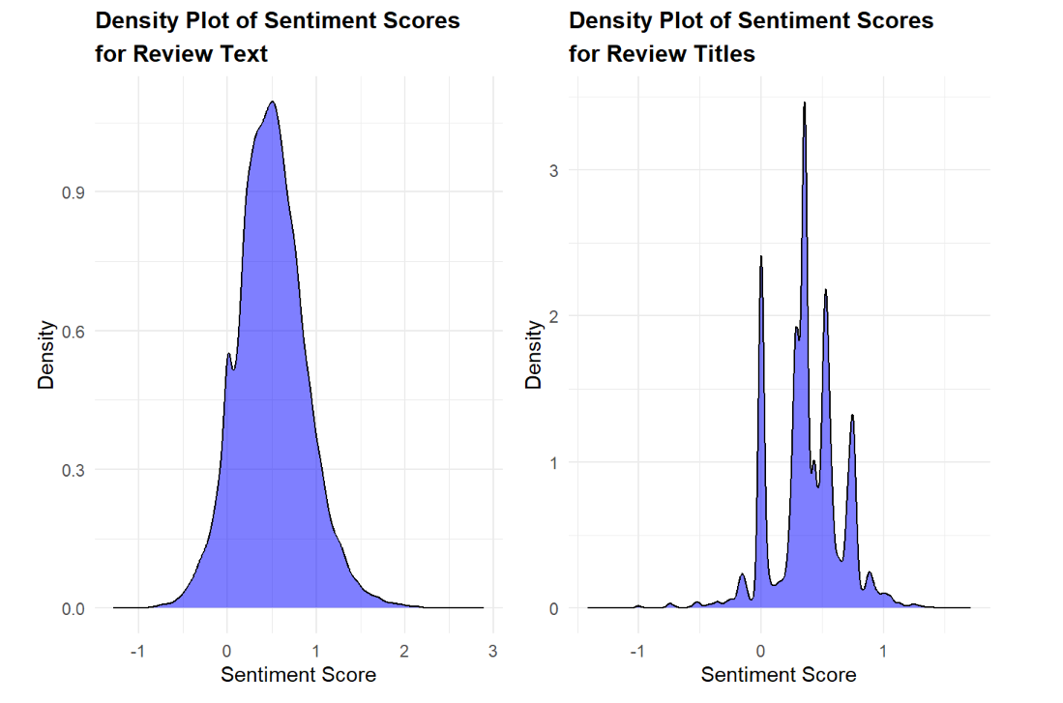
TEXT DATA PREPARATION AND SENTIMENT SCORE EXTRACTION
JEFF BEZOS
Founder

Slide 10
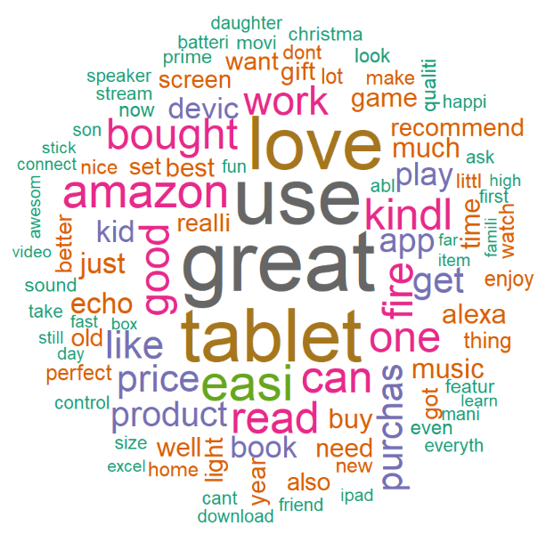
VISUALIZING CUSTOMER SENTIMENTS:
Word Cloud (Reviews-based)
‘great’ and ‘use’ are most frequently - customers find the product to be of high quality
‘tablet’ and ‘love’ are the second most common -customers are expressing their appreciation for the tablets
‘amazon’, ‘bought’, ‘good’, ‘read’, ‘work’, ‘kindle’, and ‘one’. - significant in frequency
JEFF BEZOS
Founder

Slide 11
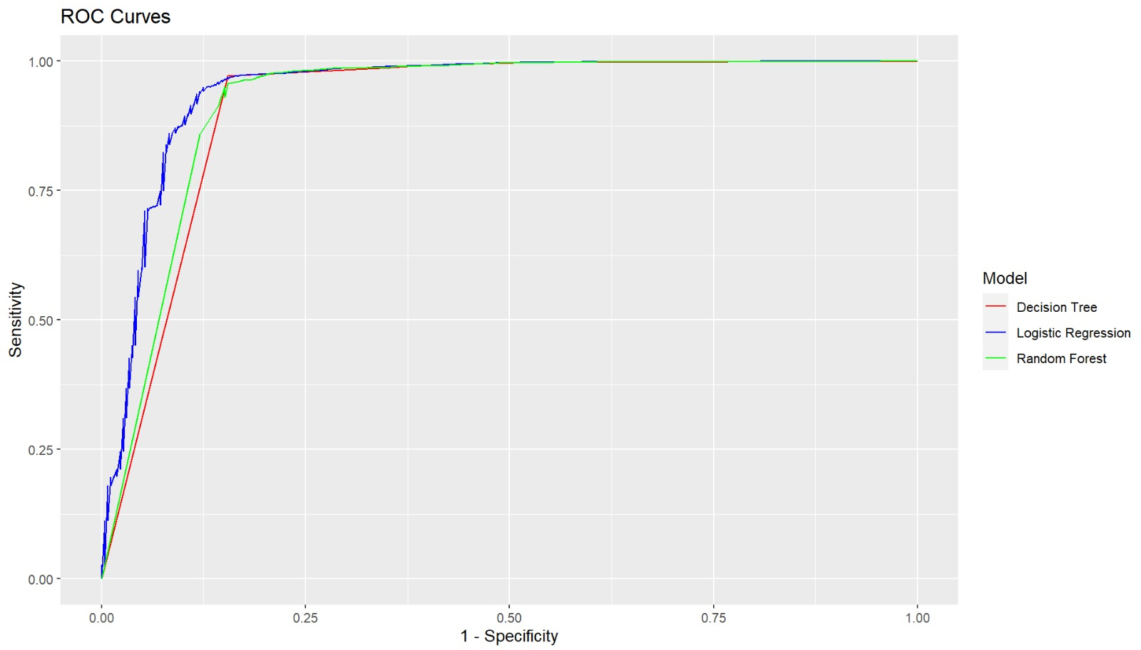
MODEL EVALUATION – BUSINESS QUESTION 1
Predict whether customer is going to recommend the product or not?
 | Logistic | Classification Tree | Random Forest
Sensitivity | 49.4% | 61.5% | 52.8%
specificity | 99.6% | 99.1% | 99.5%
Accuracy | 97.7% | 97.6% | 97.7%
AUROC | 94.6% | 91.5% | 92.2%
Balanced Accuracy | 74.5% | 80.3% | 76.1%
As our focus is on identifying the customer who will not recommend the product, so we would focus on sensitivity metric, and it is considerably higher for Classification Tree and sensitivity is also same across all the models. Classification Tree model demonstrates the best overall performance in terms of balanced accuracy, making it the preferred choice for this business question.
JEFF BEZOS
Founder

Slide 12
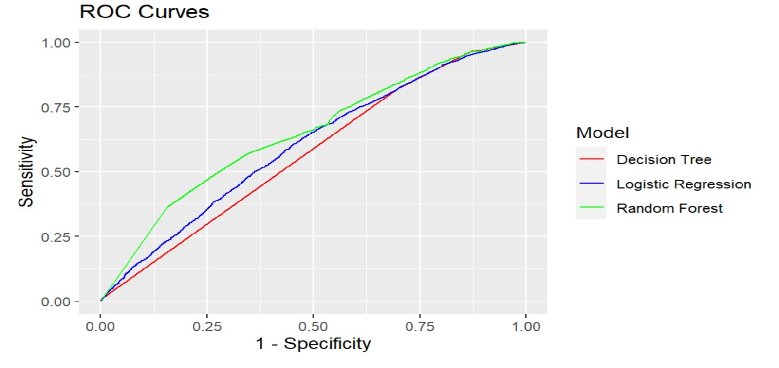
 | Logisitic | Classification Tree | Random Forest
Sensitivity | 55.2% | 29.79% | 10.20%
specificity | 61.6% | 82.45% | 97.00%
Accuracy | 59.1% | 62.00% | 63.40%
AUROC | 62.0% | 63.11% | 63.92%
Balanced Accuracy | 58.3% | 56.12% | 53.60%
MODEL EVALUATION – BUSINESS QUESTION 2
Predict whether the customer is going to give rating of 5 or not?
As our focus is on identifying customers who will not give a rating of 5, we would pay more attention to the specificity metric, as it measures the model's ability to correctly identify customers who will not give a rating of 5. Random Forest model is the best choice, as it has the highest specificity of 97%

Slide 13
MODEL EVALUATION – BUSINESS QUESTION 3
 | Multinomial logistic | Classification Tree | Random Forest
Senstivity | 57.1% | 56.7% | 57.0%
specificity | 74.2% | 74.1% | 74.1%
Accuracy | 54.1% | 57.6% | 54.4%
Balanced Accuracy | 65.5% | 65.4% | 65.5%
Predict which rating customer is going to give 5, 4 or below 4 (3-1)?
Classification Tree model has the highest overall accuracy at 57.6%, which indicates it performs better overall in classifying the ratings correctly compared to the other models. The Classification Tree model appears to be the best choice for this business question.

Slide 14
RECOMMENDATIONS
collect more data on empty variables, such as reviews.didPurchase and reviews.id. - knowing if the customer giving the review purchased the product can help to differentiate between genuine and fake reviews. - reviews.id can provide a unique identifier for each review, which can be used to avoid duplicates and improve accuracy of analysis
collect more data on empty variables, such as reviews.userCity and reviews.userProvince - gain insights into geographic distribution of customers and tailor marketing strategies
identified that Monday is most favorable day to request reviews from customers as they are more likely to leave positive feedback - information valuable for businesses - strategically plan their review requests and increase likelihood of receiving positive reviews -businesses can leverage this insight to enhance their customer satisfaction and overall success
recommendations, ratings, and use of tablets have a significant impact on the overall good reviews - inform marketing and product development strategies
collect more data that focuses on negative customer feedback, especially on variables such as reviews.doRecommend, reviews.ratings, snt_scr_text, snt_scr_title, Tblts, AmzDvcs, Accz, Elec, and OffnBuss, to enhance accuracy

Slide 15
Thank you!

Slide 16
APPENDIX!

Slide 17
DATA DICTIONARY:
No. | Variable Name | Data Type | Data type used for analysis | Variables choose for this study | Description
1 | id | Alphanumeric | Chr |  | Unique identifier for the product.
2 | name | Character | Chr |  | Name of the product.
3 | asins | Character | Chr |  | Amazon Standard Identification Numbers for the product.
4 | brand | Character | Factor |  | Brand of the product.
5 | categories | Character | Chr | ü (made 5 product groups from this feature) | Categories the product belongs to, separated by commas.
6 | keys | Character | Chr |  | Various identifiers and keys related to the product, separated by commas.
7 | manufacturer | Character | Factor |  | Manufacturer of the product.
8 | reviews.date | Date | Date |  | Date when the review was written.
9 | reviews.dateAdded | Date | Date |  | Date when the review was added to the dataset.
10 | reviews.dateSeen | Character | Chr |  | Dates when the review was seen online, separated by commas.
11 | reviews.didPurchase | Logical | logi |  | Indicates if the reviewer purchased the product (TRUE) or not (FALSE).
12 | reviews.doRecommend | Logical | logi | ü | Indicates if the reviewer recommends the product (TRUE) or not (FALSE).
13 | reviews.id | Numeric | Int |  | Unique identifier for the review.
14 | reviews.numHelpful | Numeric | num |  | Number of people who found the review helpful.
15 | reviews.rating | Numeric | num | ü | Rating given by the reviewer on a scale of 1 to 5, with 1 being the lowest and 5 the highest.
16 | reviews.sourceURLs | Character | Chr |  | URLs where the review was found, separated by commas.
17 | reviews.text | Character | Chr | ü | Text of the review.
18 | reviews.title | Character | Chr | ü | Title of the review.
19 | reviews.userCity | Character | logi |  | City of the reviewer.
20 | reviews.userProvince | Character | logi |  | Province of the reviewer.
21 | reviews.username | Character | Chr |  | Username of the reviewer.

Slide 18
MULTINOMIAL LOGISTIC REGRESSION :
Metric | Class: 4 | Class: 5 | Class: below_4
Accuracy | 54.14% | 54.14% | 54.14%
Sensitivity | 63.90% | 50.25% | 57.10%
Specificity | 51.80% | 71.40% | 99.50%
Precision | 30.50% | 78.60% | 89.10%
Balanced Accuracy | 57.60% | 60.70% | 78.30%

Slide 19
DECISION TREE:
Metric | Class: 4 | Class: 5 | Class: below_4
Accuracy | 57.6% | 57.6% | 57.6%
Sensitivity | 54.2% | 58.8% | 57.1%
Specificity | 60.0% | 62.9% | 99.5%
Precision | 31.0% | 77.1% | 89.4%
Balanced Accuracy | 60.8% | 57.1% | 78.2%

Slide 20
RANDOM FOREST:
Metric | Class: 4 | Class: 5 | Class: below_4
Accuracy | 54.4% | 54.4% | 54.4%
Sensitivity | 63% | 51.0% | 57.1%
Specificity | 52.6% | 70.3% | 99.4%
Precision | 30.6% | 78.4% | 89.3%
Balanced Accuracy | 57.8% | 60.6% | 78.2%

Slide 21
ROC CURVES FOR Q2 FOR MODELS BUILT ON IMBALANCED DATA

Slide 22

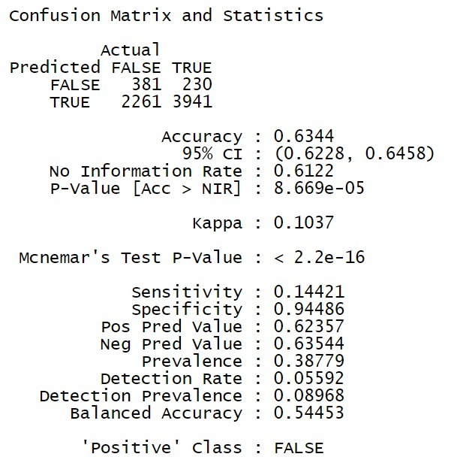
Q2 : LOGISTIC MODEL PREDICATIVE PERFORMANCE USING IMBALANCED DATA

Slide 23
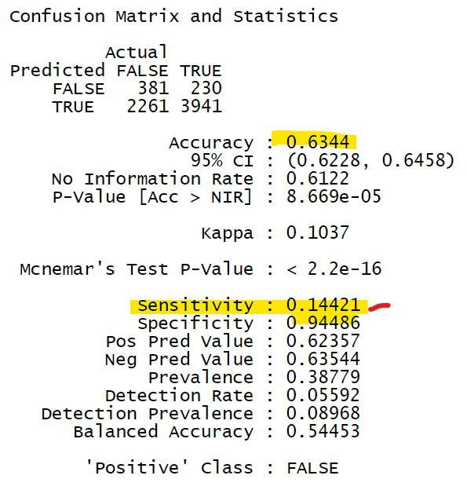
Q2 : LOGISTIC MODEL PREDICATIVE PERFORMANCE USING IMBALANCED DATA

Slide 24
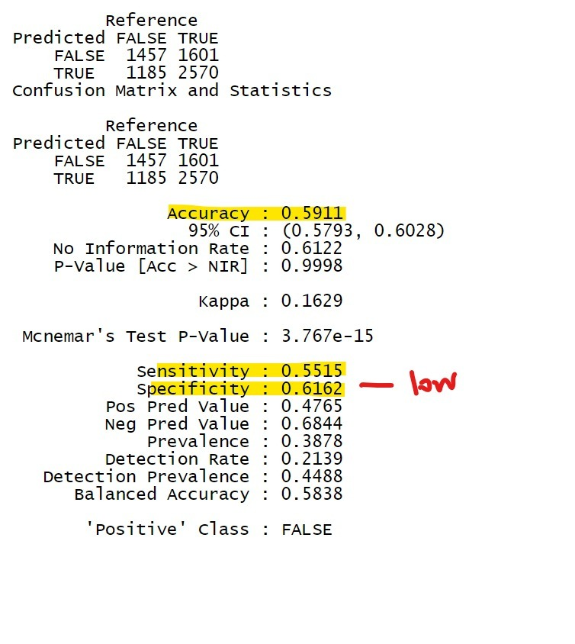
Q2 : LOGISTIC MODEL PREDICATIVE PERFORMANCE USING BALANCED DATA

Slide 25
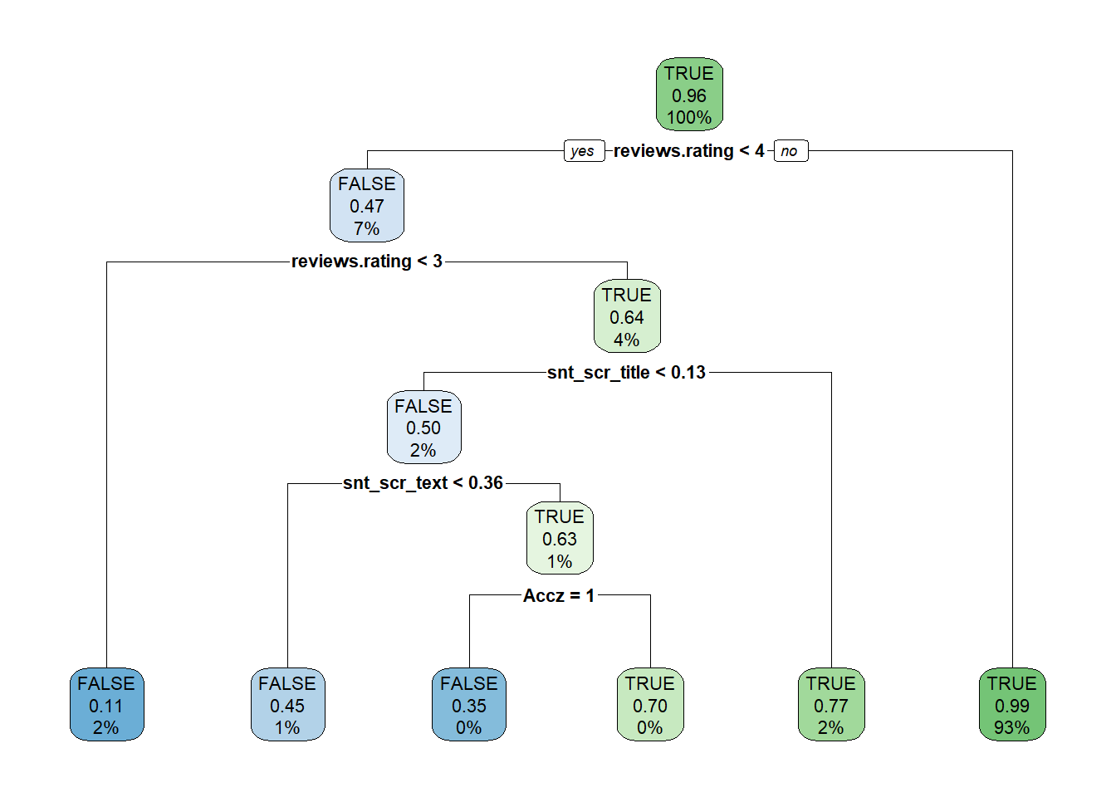
RUNNING DECISION TREES ON UNBALANCE TRAINING DATA ON BUSINESS QUESTION 1:-

Slide 26
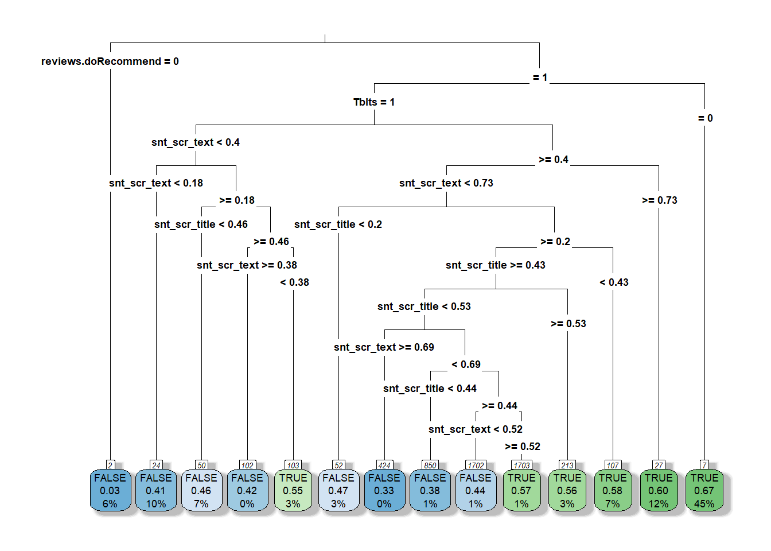
RUNNING DECISION TREE ON BUSINESS QUESTION :2

Slide 27
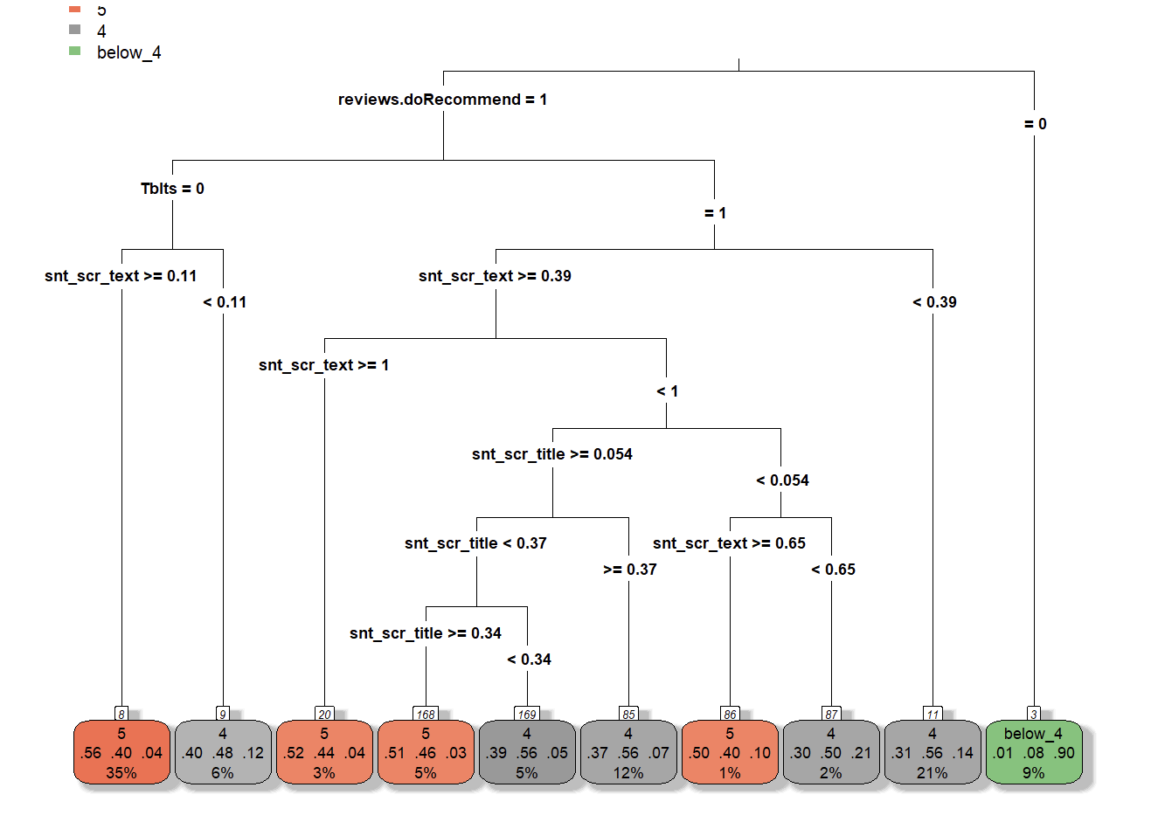
RUNNING DECISION TREE ON BUSINESS QUESTION :3

Slide 28
MISSING VALUES
No. | Variable Name | Description | New Data type | Missing Values in each column | %age of data missing from total obv of entire var | which method to use to fill in the missing values.
8 | reviews.date | Date when the review was written. | Date | 39 | 0.1% | deleting observations
9 | reviews.dateAdded | Date when the review was added to the dataset. | Date | 10,621 | 31% | Feature not important/ not included in model building
12 | reviews.doRecommend | Indicates if the reviewer recommends the product (TRUE) or not (FALSE). | logical (T/F) | 594 | 1.7% | deleting observations
14 | reviews.numHelpful | Number of people who found the review helpful. | numeric | 529 | 1.5% | deleting observations
15 | reviews.rating | Rating given by the reviewer on a scale of 1 to 5, with 1 being the lowest and 5 the highest. | numeric | 33 | 0.10% | deleting observations
 |  |  |  | 11,816

Slide 29
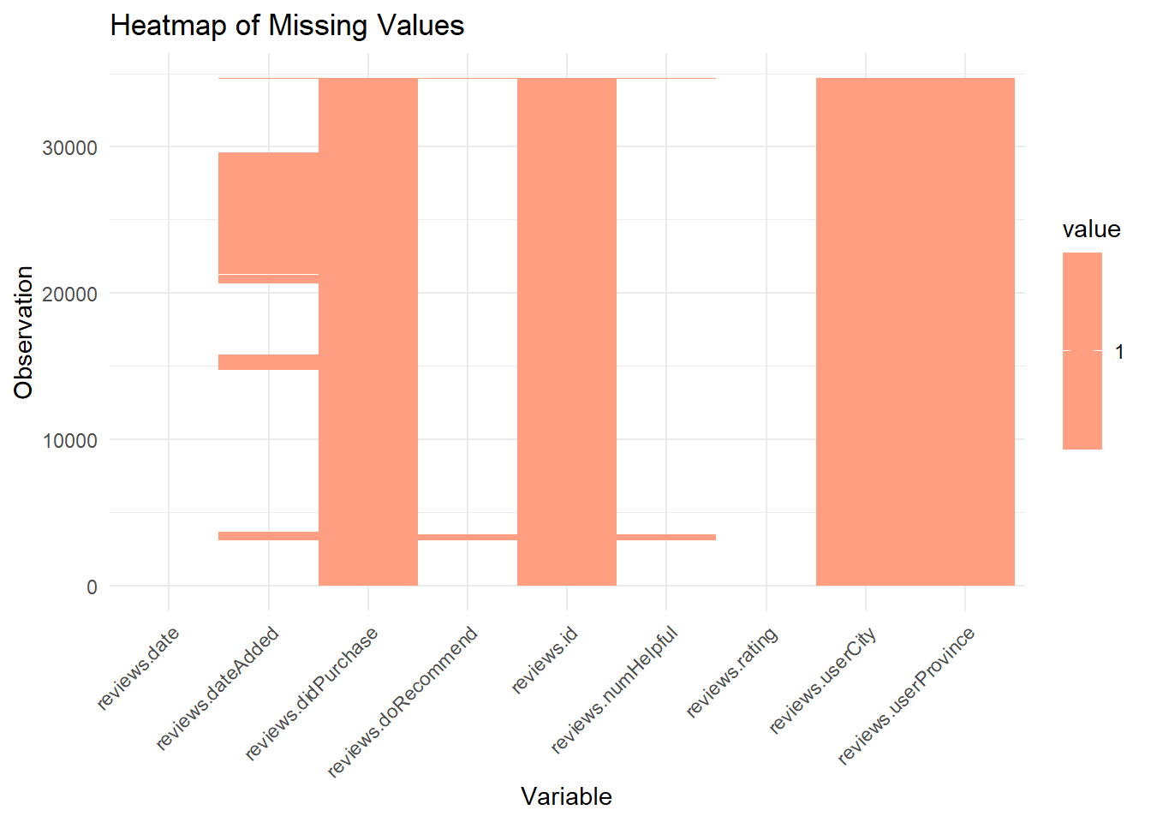

Slide 30
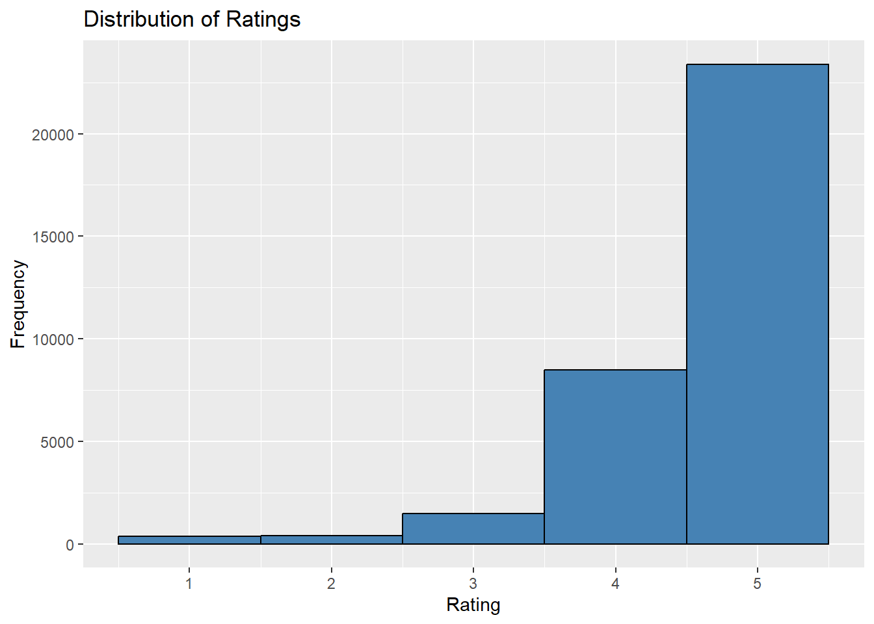

Slide 31
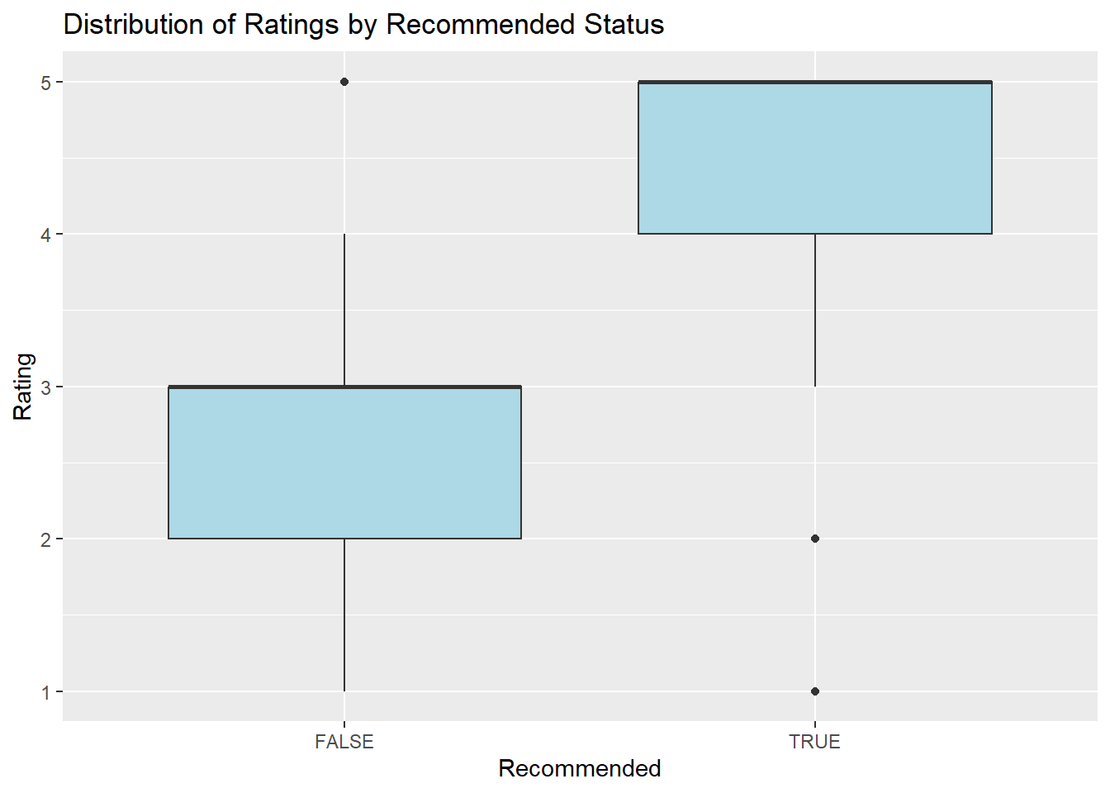

Slide 32
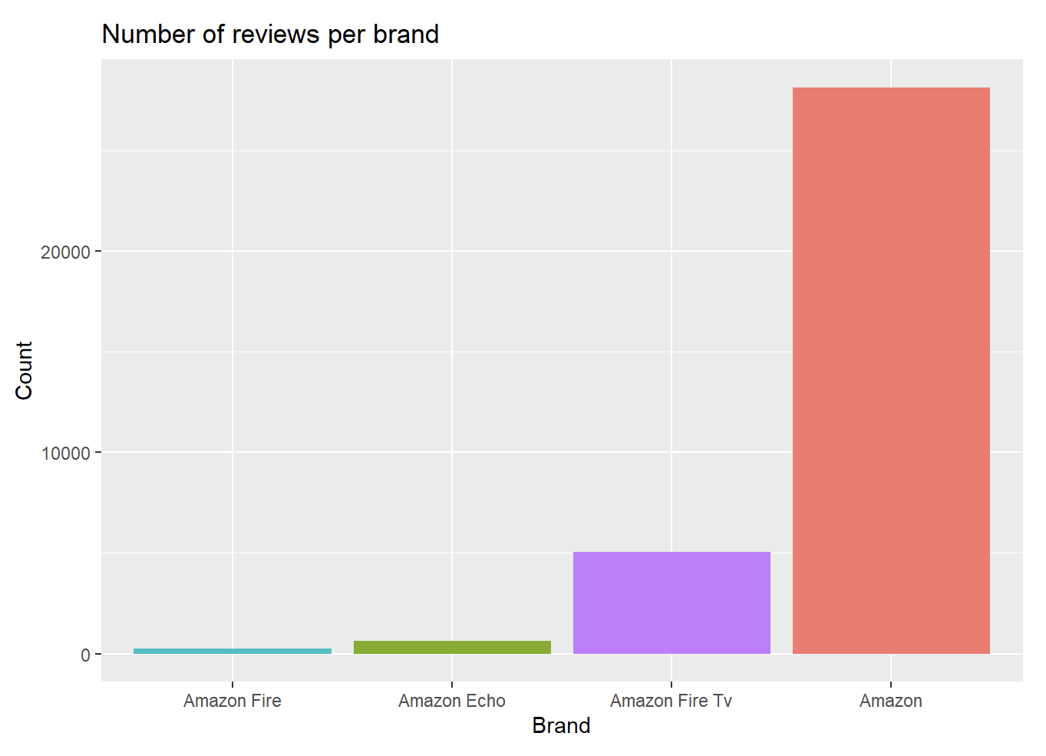

Slide 33
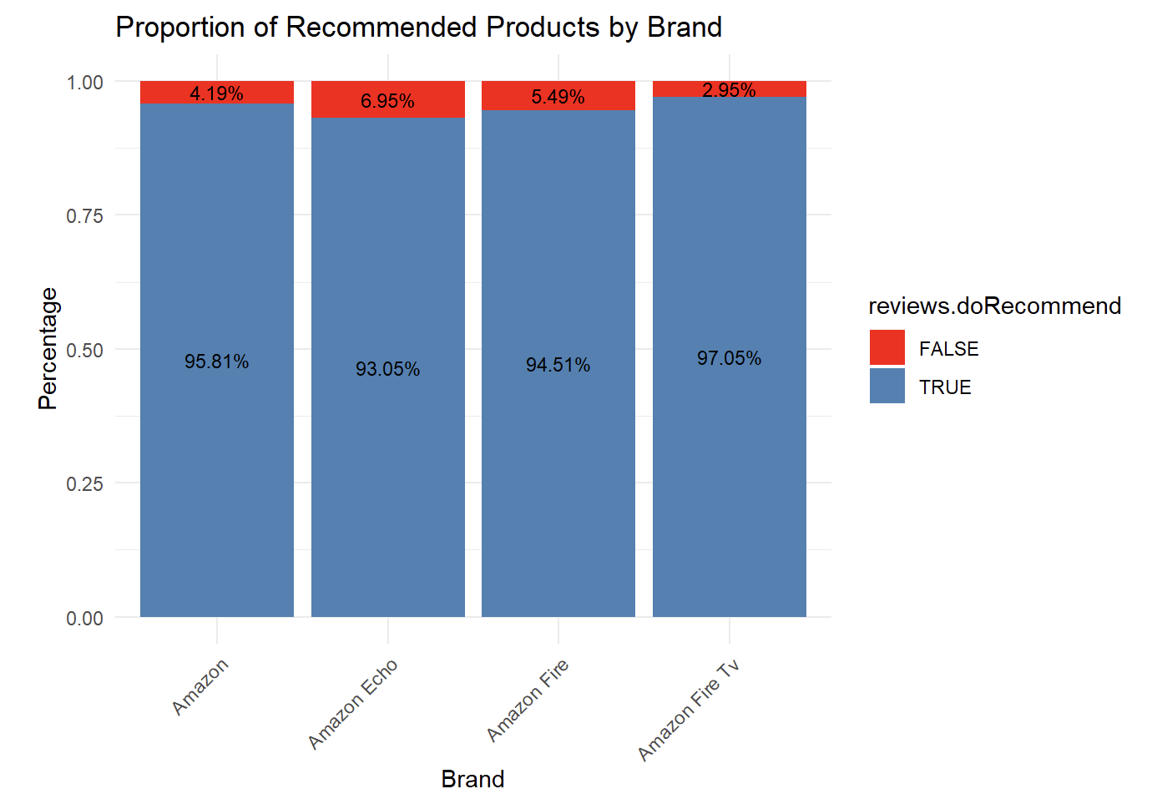

Slide 34
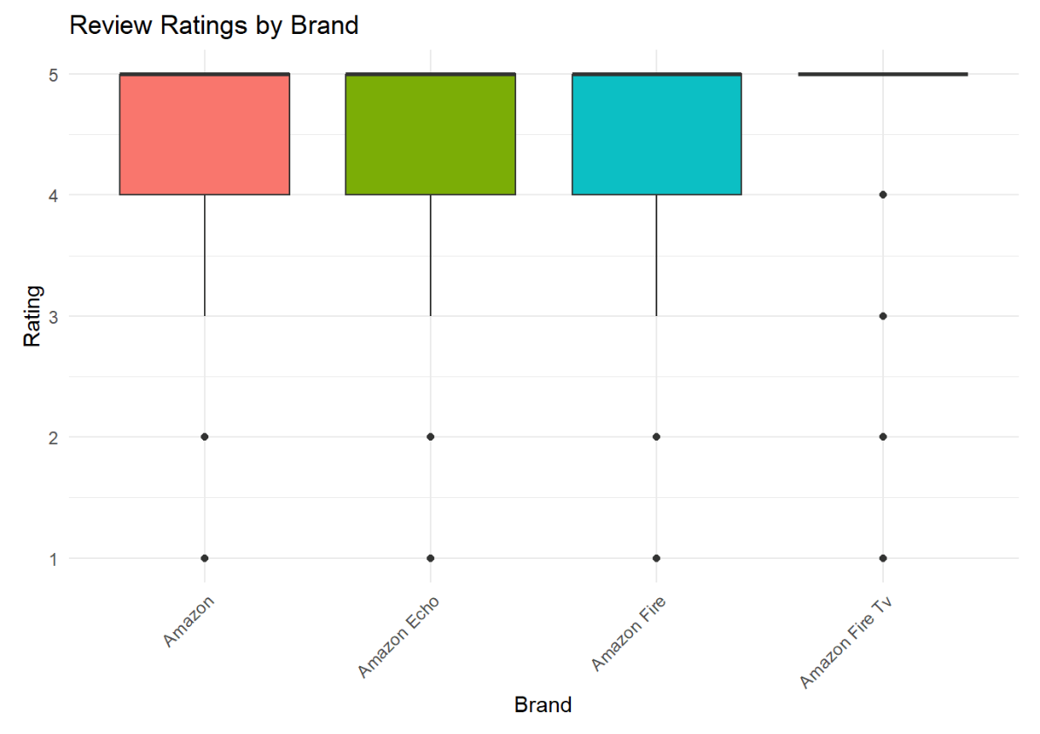

Slide 35
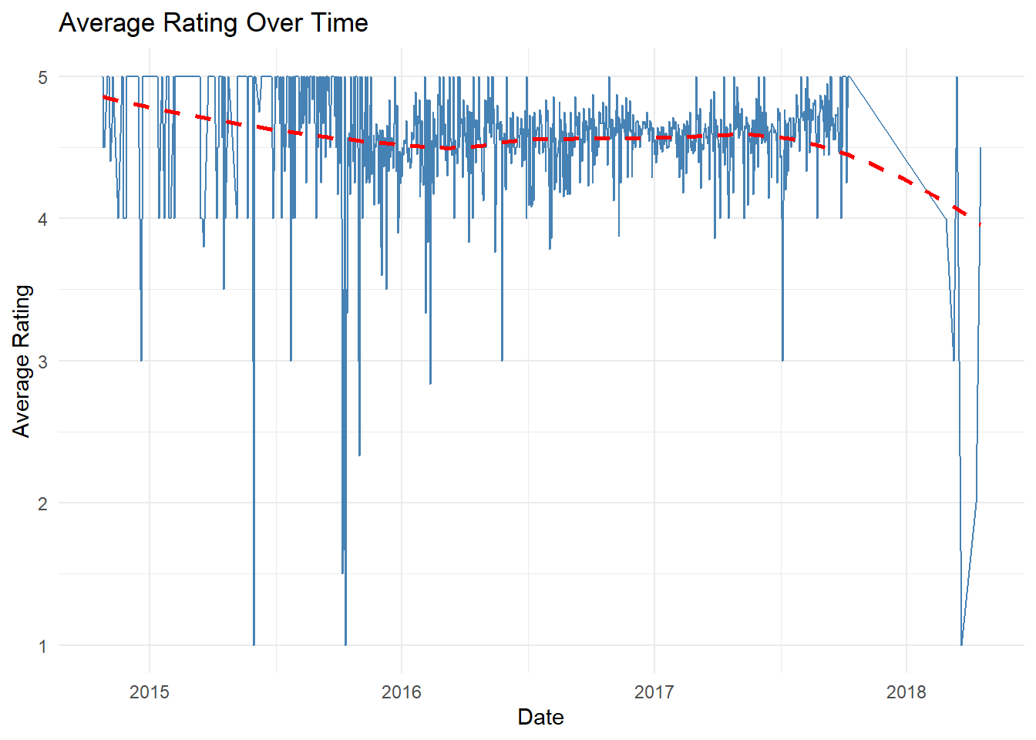

Slide 36
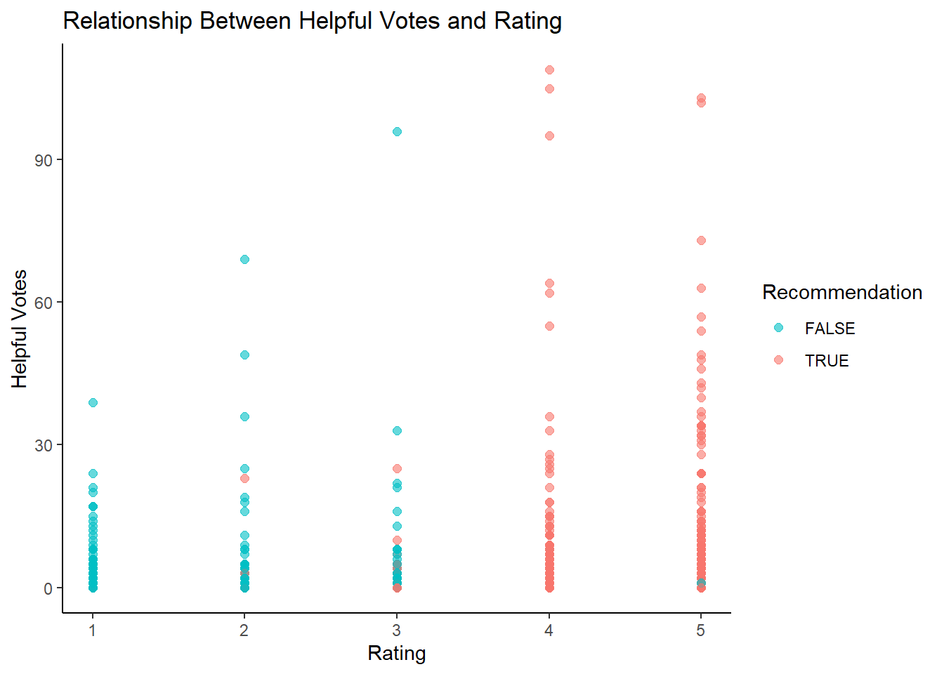

Slide 37
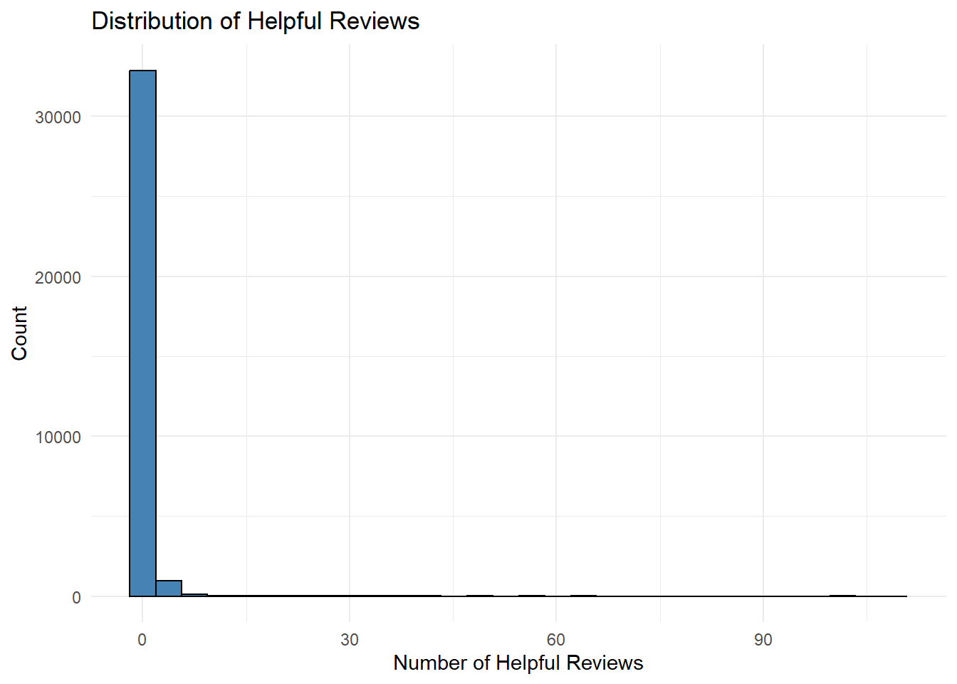

Slide 38
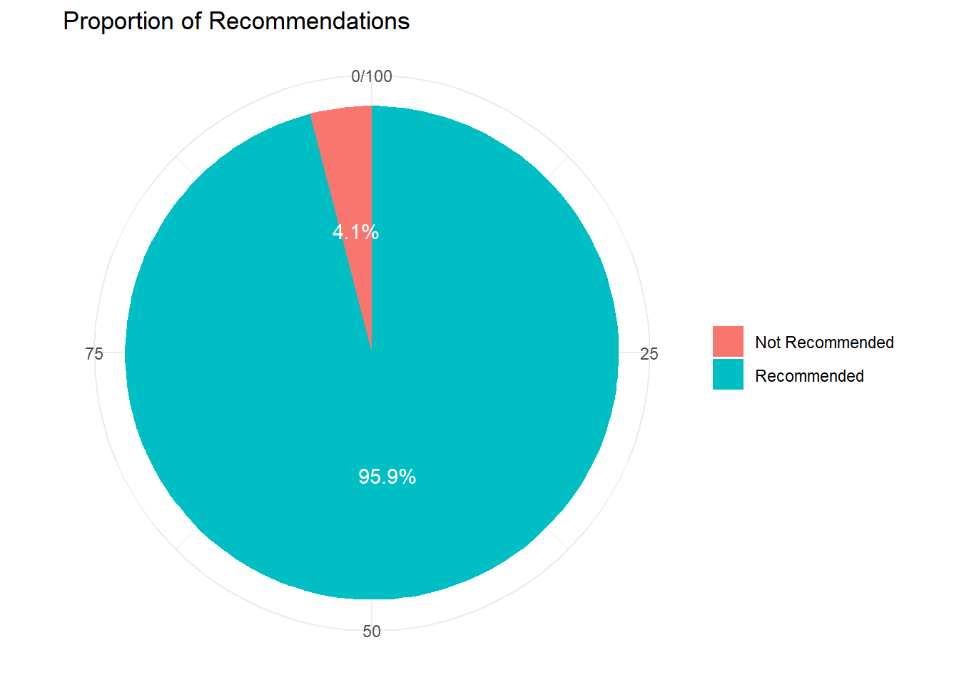

Slide 39
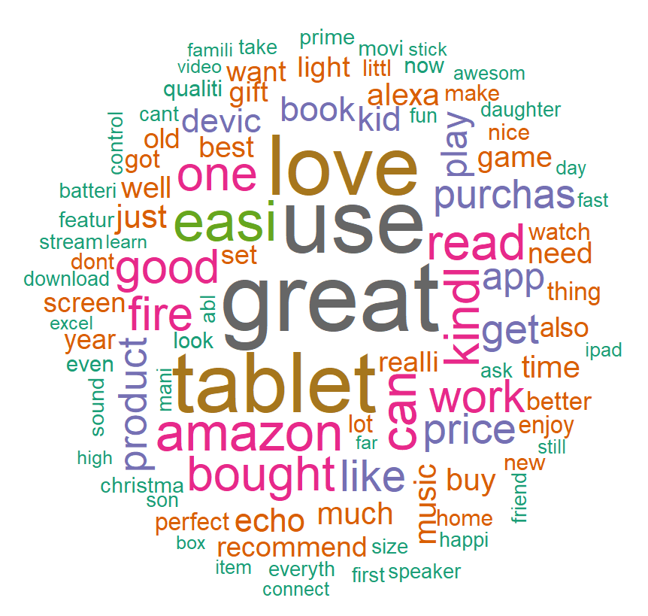
MOST FREQUENTLY MENTIONED WORDS IN THE REVIEWS

Slide 40
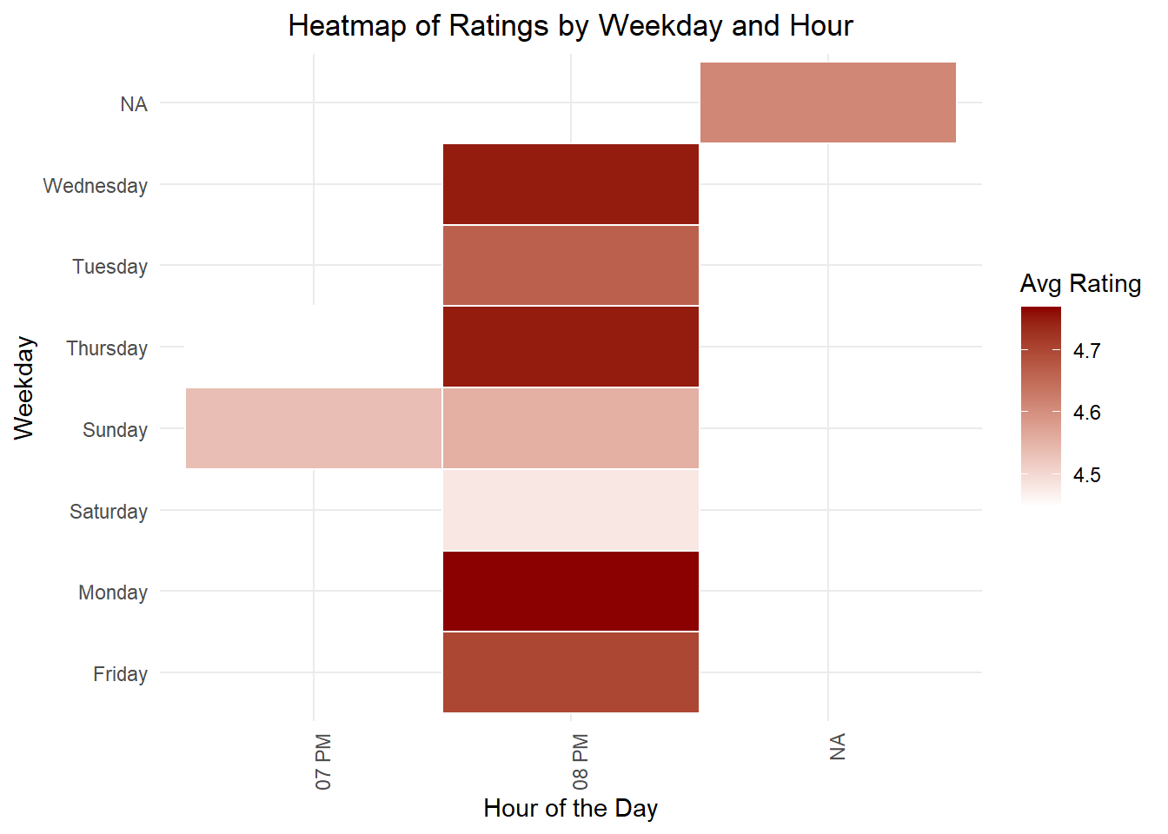

Slide 41
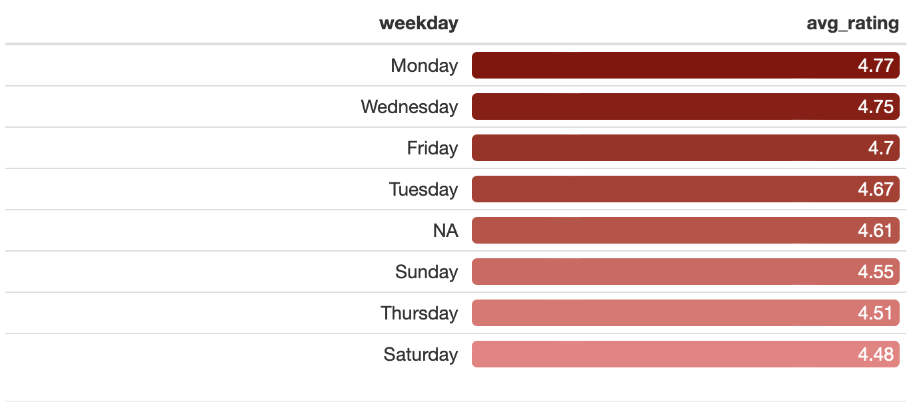
AVERAGE RATING BY DAY:

Slide 42
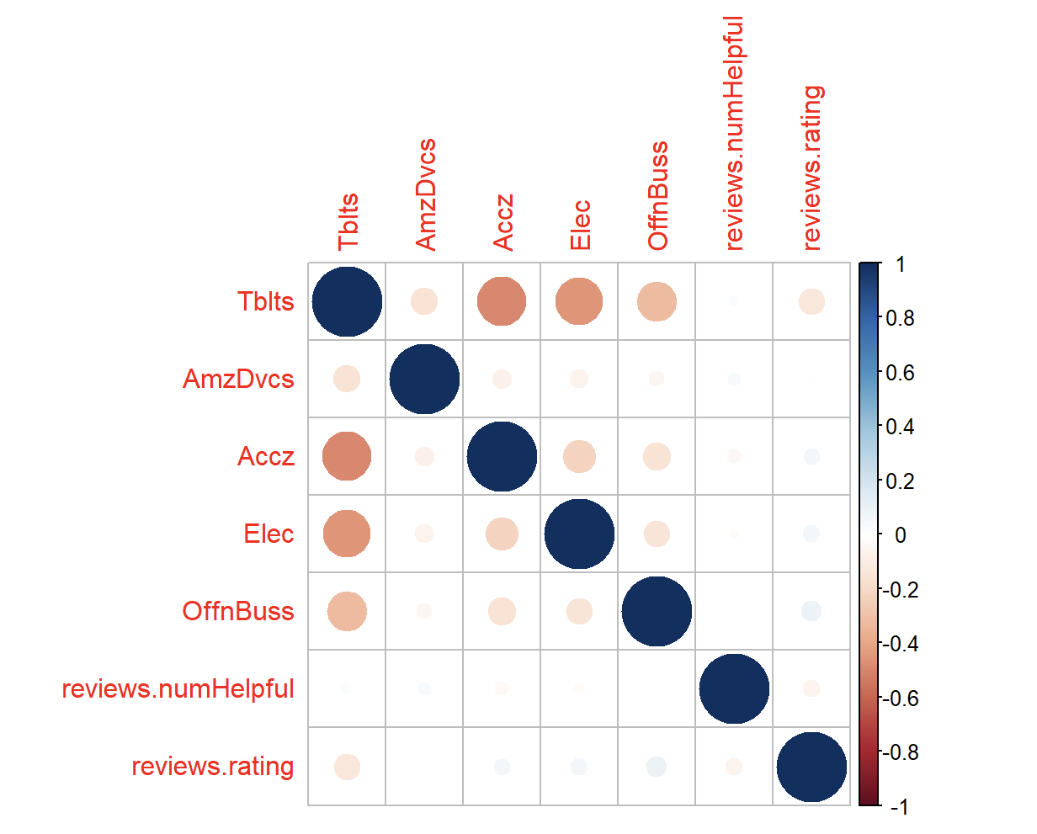
EXPLORING RELATIONSHIP OF THESE NEW VARIABLES WITH OTHER VARIABLES OF THE DATASET:-

Slide 44
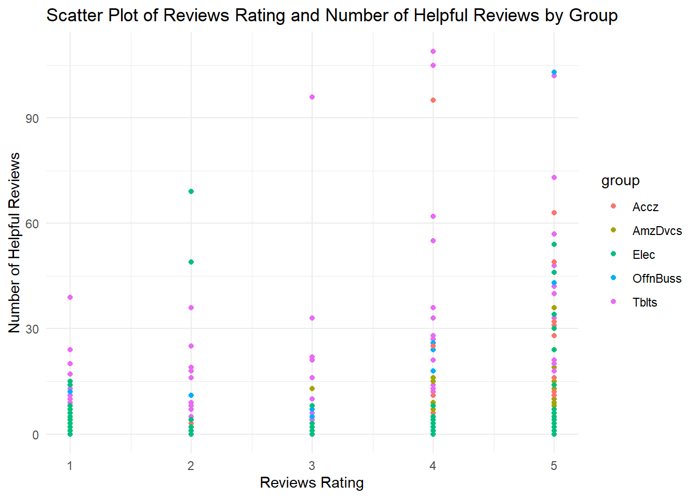

Slide 48
PRODUCT GROUP SUMMARY: REVIEWS, RECOMMENDATIONS, AND AVERAGE RATINGS (PIVOT TABLE):-

Slide 49
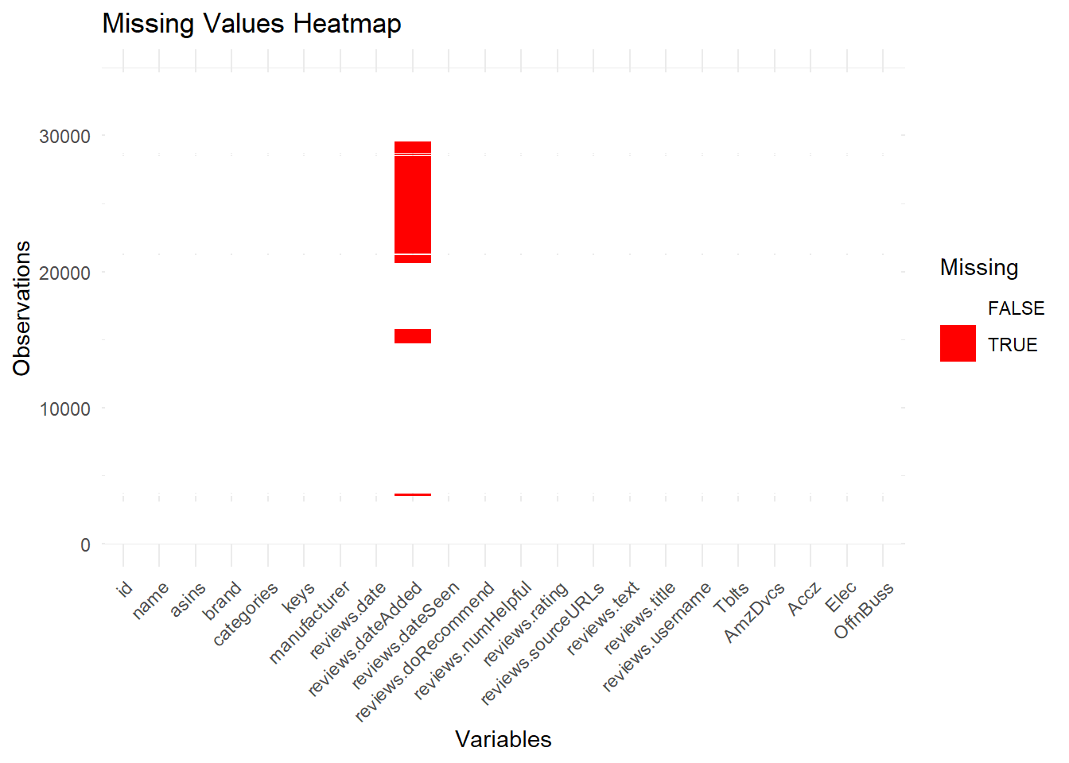

Slide 50
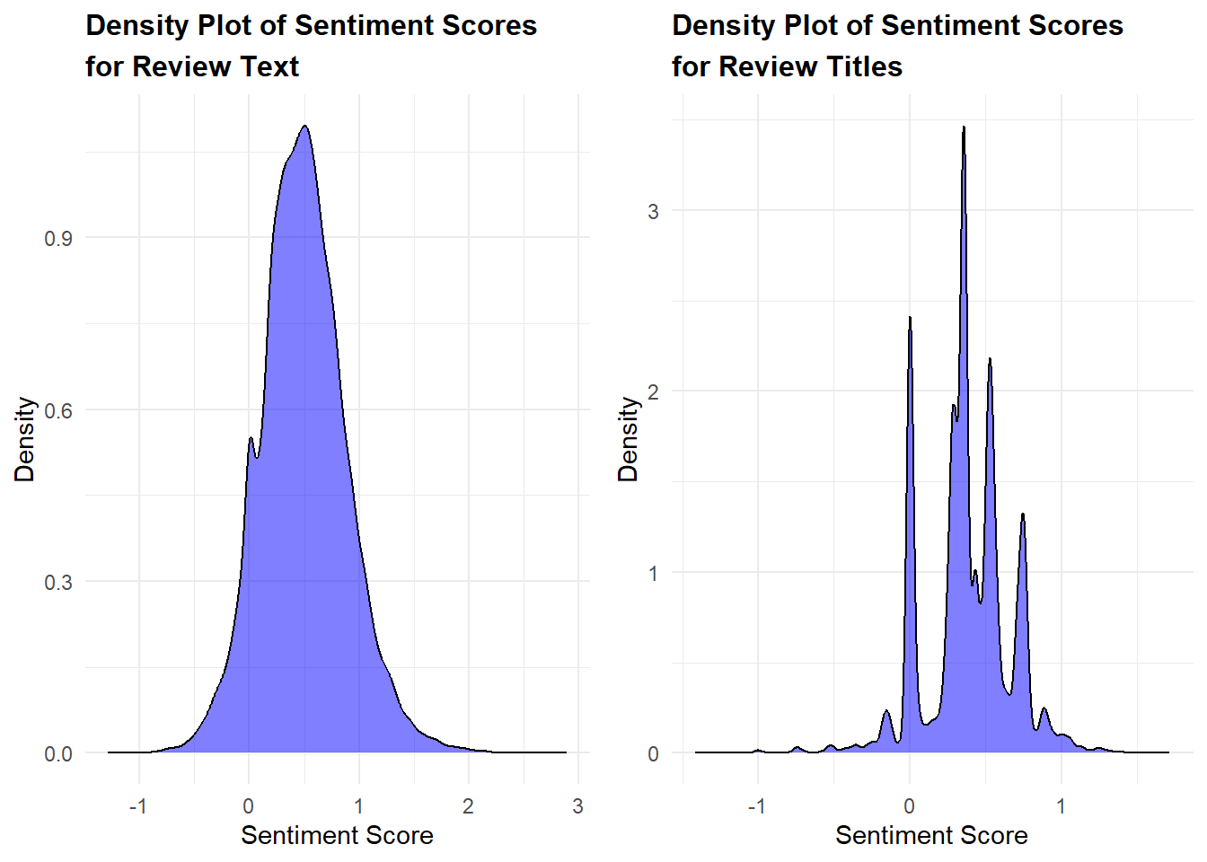

Slide 51
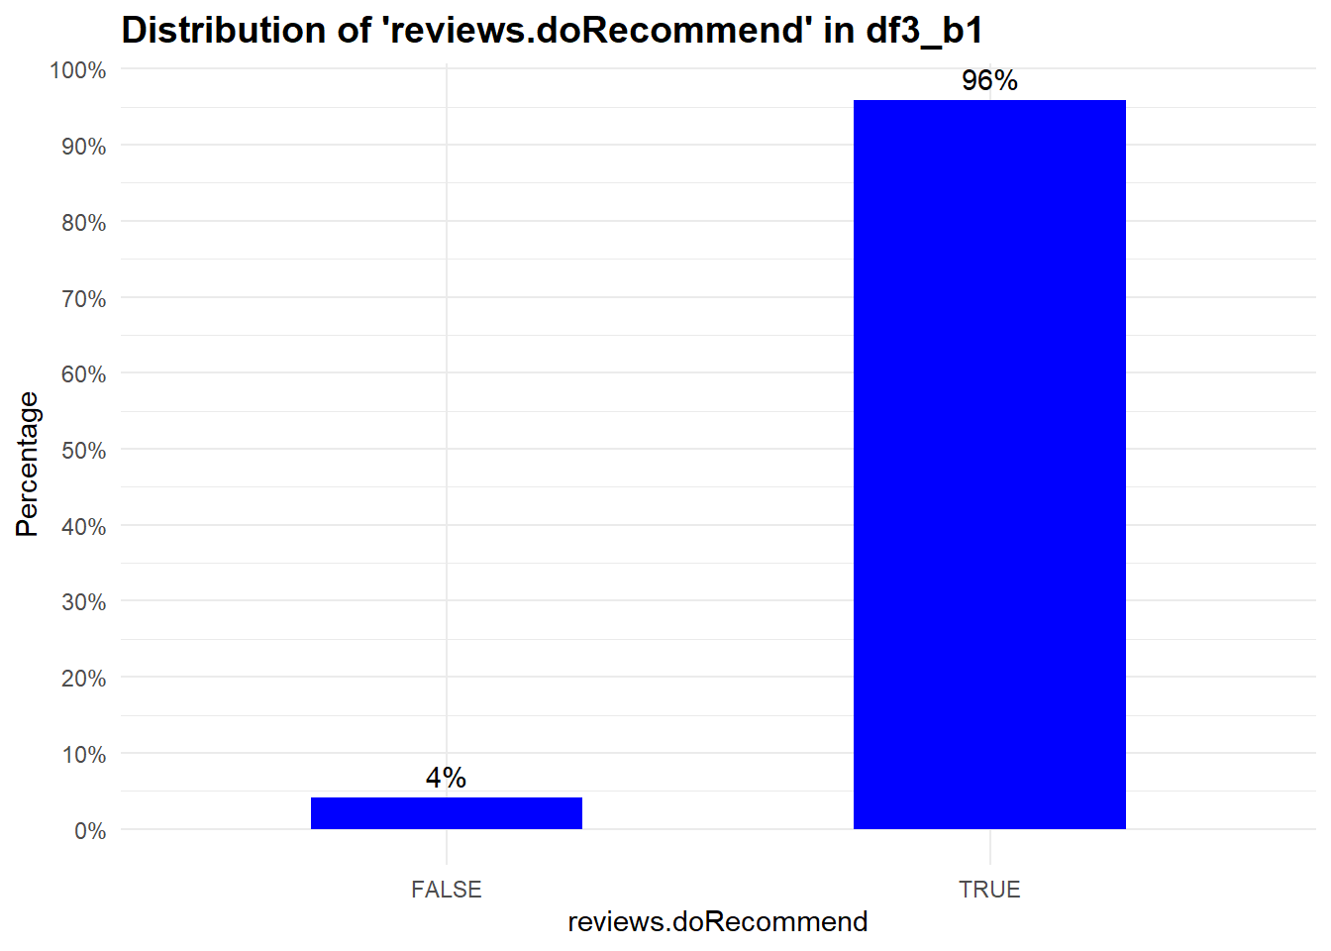

Slide 52
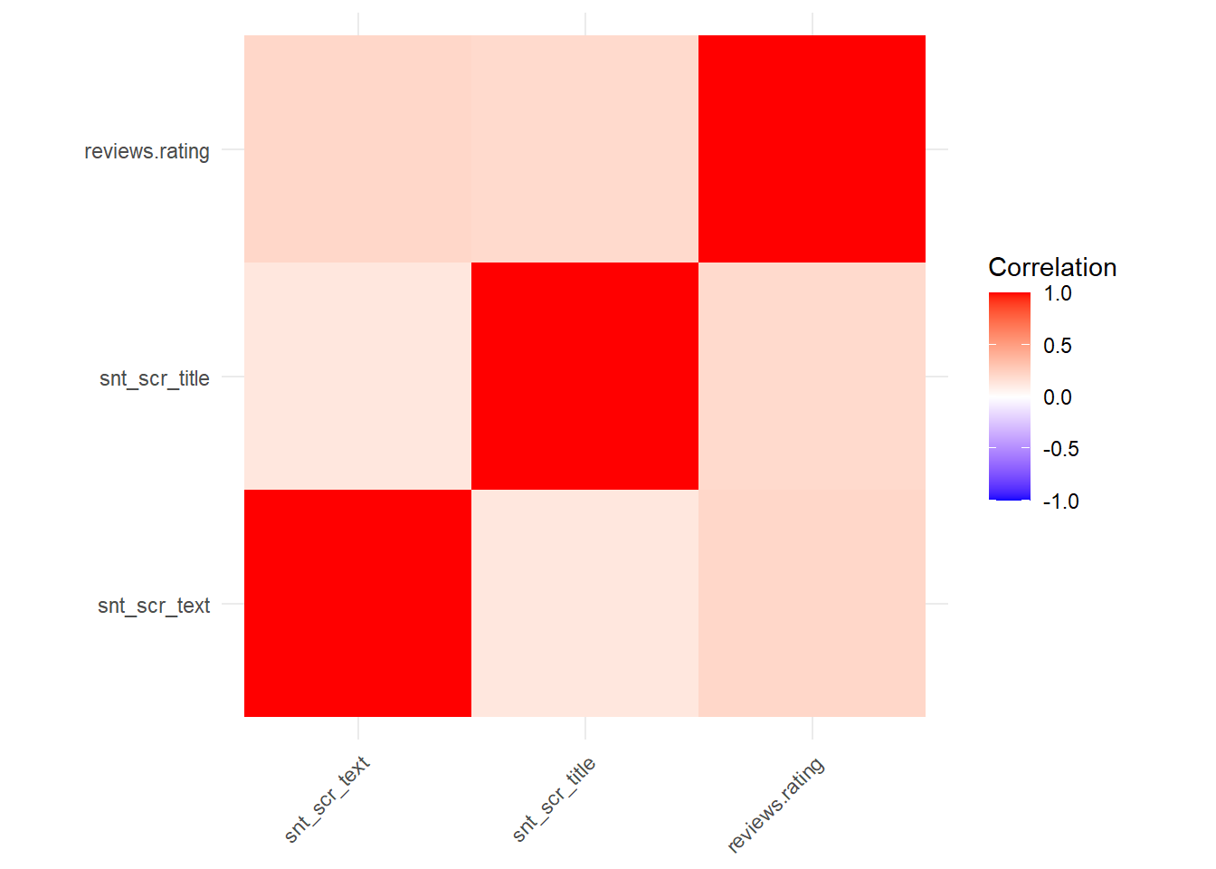
CHECKING CORRELATION B/W CONTINUOUS INDEPENDENT VARIABLES “SNT_SCR_TEXT”, “SNT_SCR_TITLE”, AND “REVIEWS.RATING”:-

Slide 53
RUNNING DECISION TREES ON UNBALANCE TRAINING DATA ON BUSINESS QUESTION 1:-

Slide 54
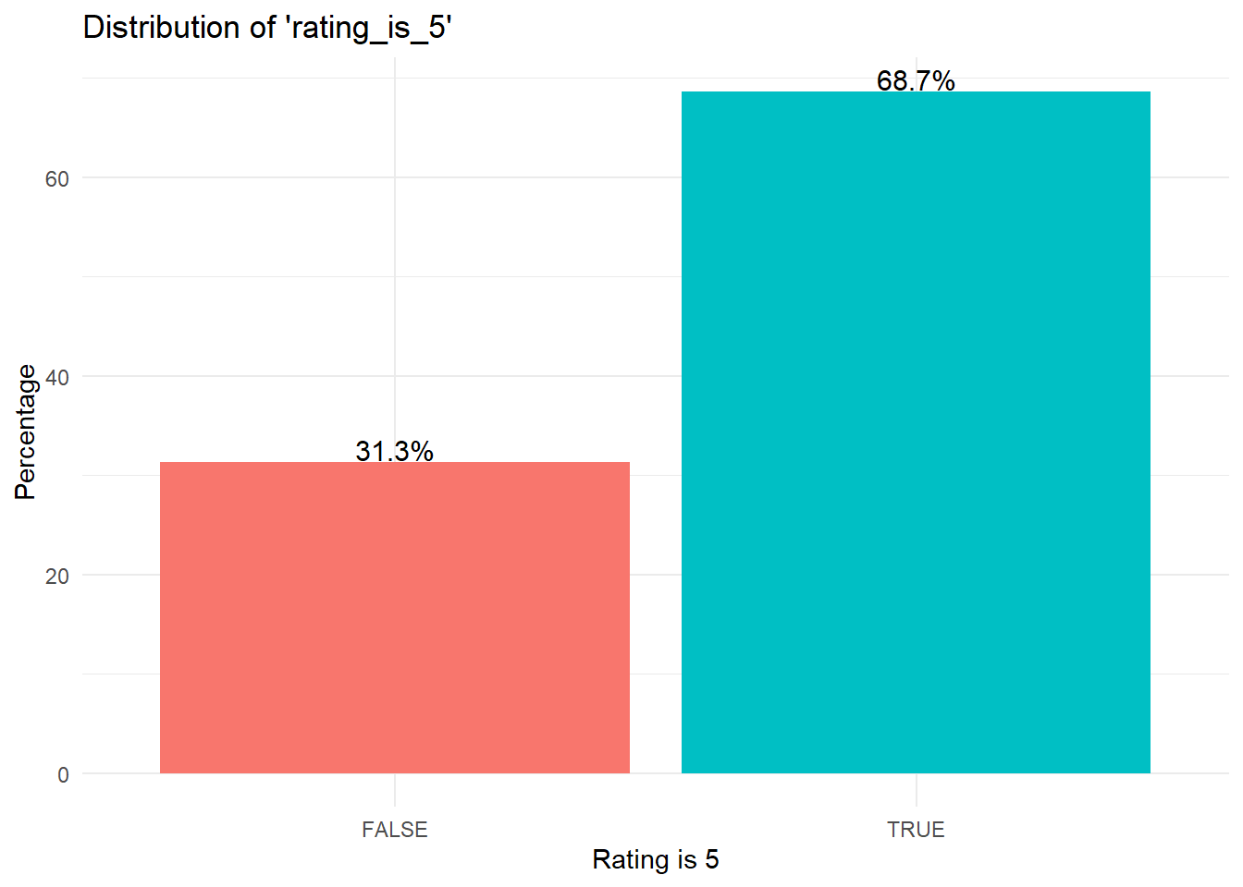
BUSINESS QUESTION 2: PREDICT WHETHER CUSTOMER WILL GIVE A RATING OF 5 OR NOT?

Slide 55
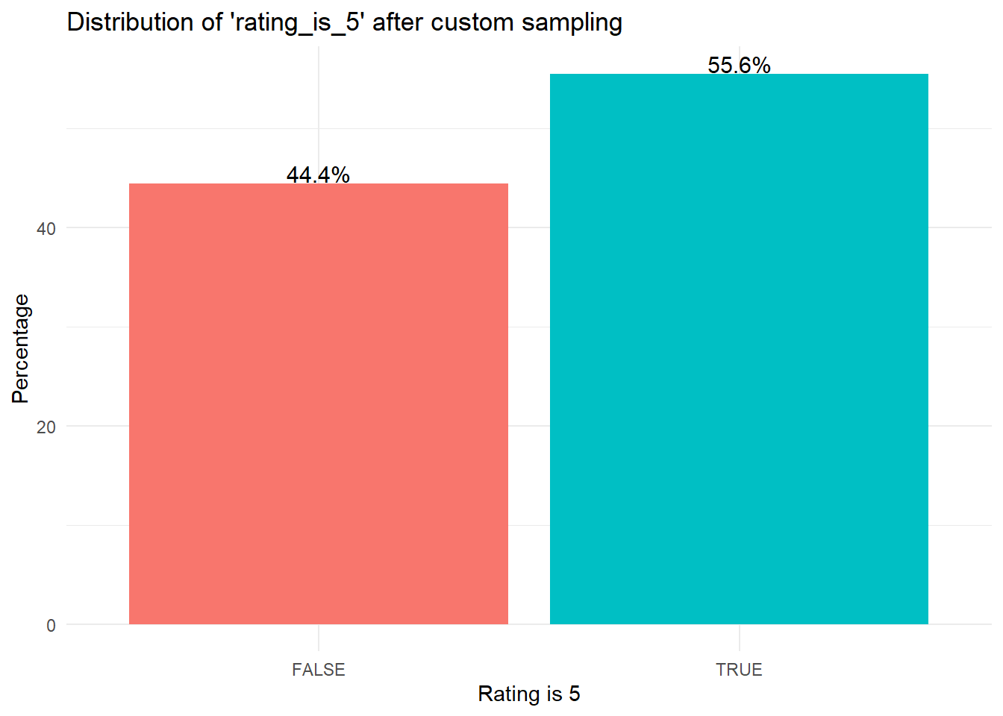
ON BALANCED DATASET:-

Slide 56
RUNNING DECISION TREE ON BUSINESS QUESTION :2

Slide 57
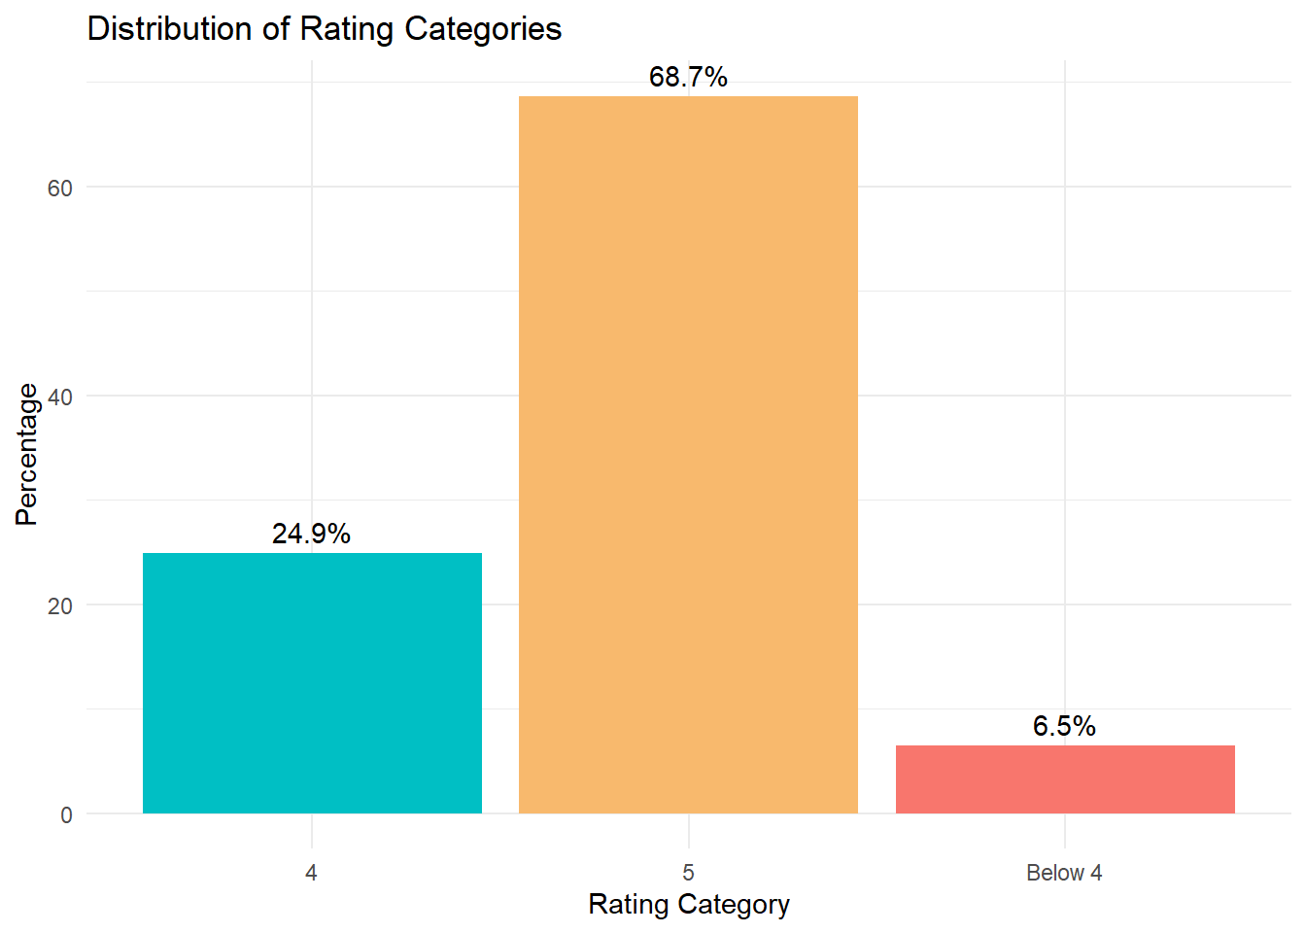
BUSINESS QUESTION 3:PREDICT WHICH RATING CUSTOMER WILL GIVE 5, 4 OR BELOW 4 (3-1)?

Slide 58
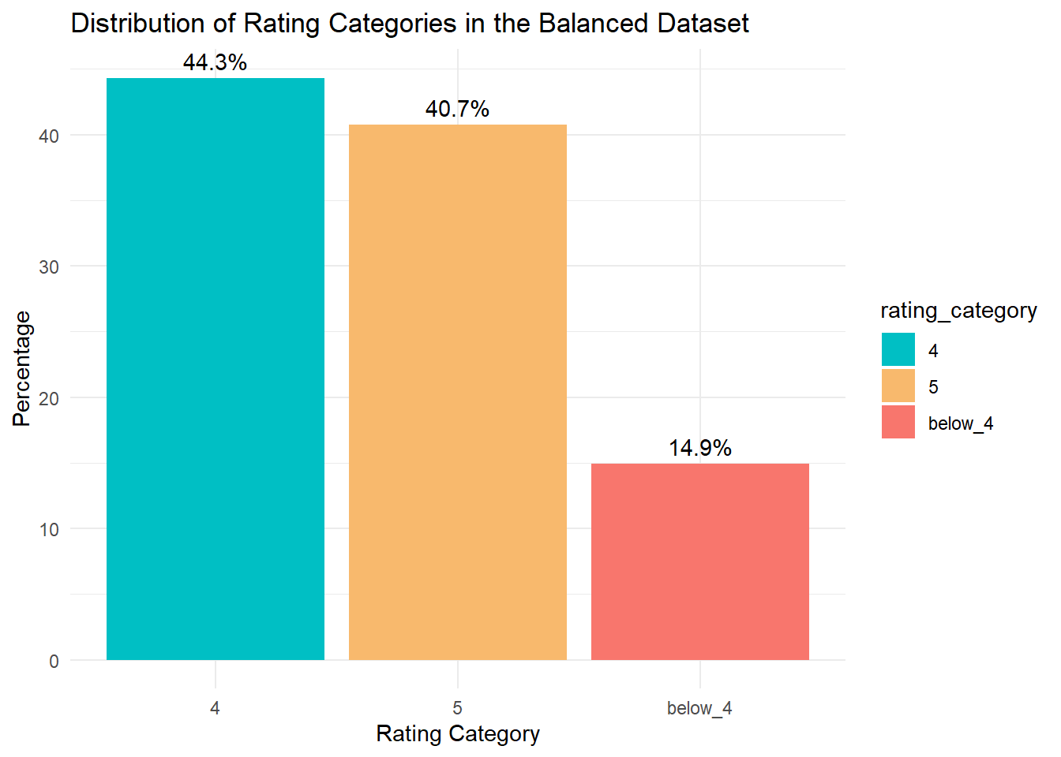

Slide 59
RUNNING DECISION-TRESS ON BUSINESS QUESTION 3:

